Slide 1
Gender-based Cyberbullying Detection for Under-resourced Bangla Language
2022 12th International Conference on Electrical and Computer Engineering (ICECE)
By Sara Jerin Prithila (21101306)
Ehsanur Rahman Rhythm (ST)
Adib Muhammad Amit (RA)
1

Slide 2
Related Works
A model supports Unicode emoticons and Bengali characters.
A novel application of BERT for cyberbullying identification.
DeepHateExplainer, an explainable hate speech recognition solution for Bengali, is under-resourced.
2

Slide 3
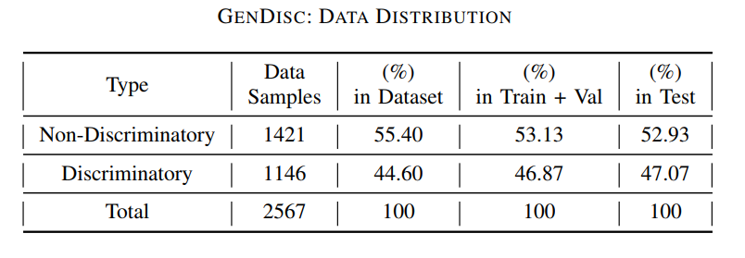
DATASET
PREPARATION
GenDisc (Gender-Based Discriminatory)
Source selection
Data sample selection criteria
Scraping
Annotation
Annotation Criteria
Data Pre-processing
Meaningless characters are removed
Eliminate stop-words
Remove duplicate data
Data Augmentation
Random swapping
3

Slide 4
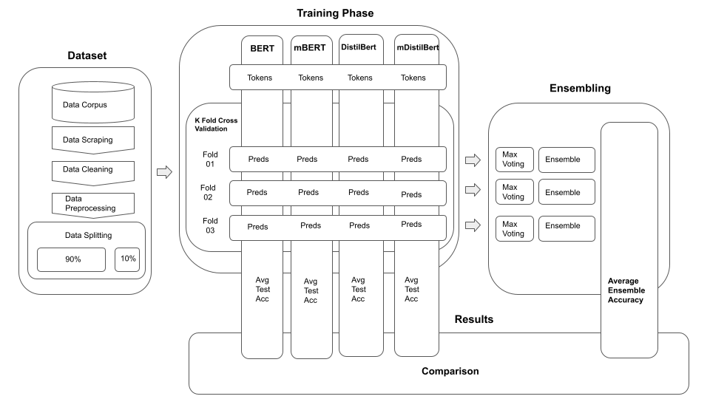
PROPOSED FRAMEWORK
Proposed Framework Architecture and Methodology
4

Slide 5
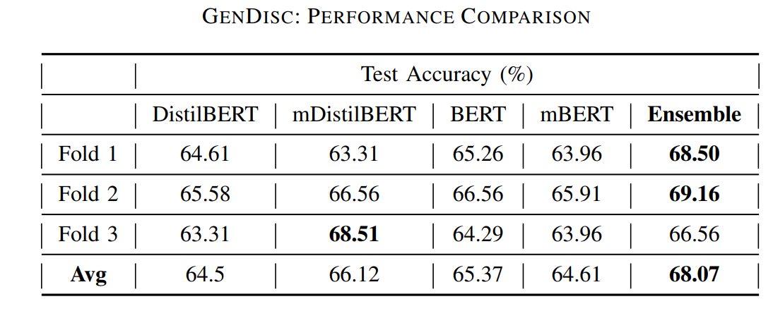
Results And Discussion
Employed a framework of four models and an ensembling technique to train a gender-based discriminating text classifier, experiments were 68% accurate.
5

Slide 6
Thank you for listening.
6

